Slide 1
Energy Calculations

Slide 2

By the end of this lesson, you should be able to do the following:
Calculate the kinetic energy of an object.
Calculate the gravitational potential energy of an object.

Slide 3

Kinetic energy is measured in joules (J).
The mass of the object must always be in kilograms (kg) and its speed must be in meters per second (m/s or ms⁻¹).

Slide 4

This is the formula for kinetic energy:
This means that kinetic energy is equal to half of the mass multiplied by the velocity squared.

Slide 5
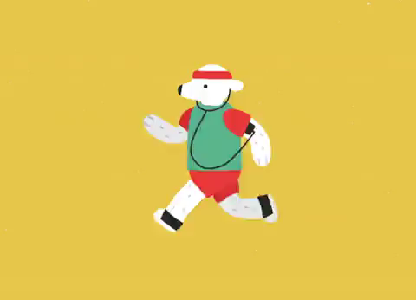
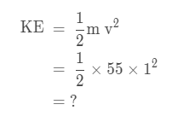
Lets practice using this formula.
Bernard has a mass of 55 kg and he is walking at a speed of 1 m/s.
What is his kinetic energy?
Try completing this equation on your own and check on the next slide for the solution!

Slide 6
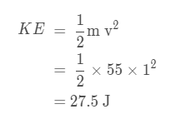
Here is the rest of the equation:
This means that Bernard has a kinetic energy of 27.5 J.

Slide 7

Gravitational potential energy is the energy stored in an object held above the ground.
The gravitational potential energy of an object depends on the mass of the object and its height above the ground.

Slide 8
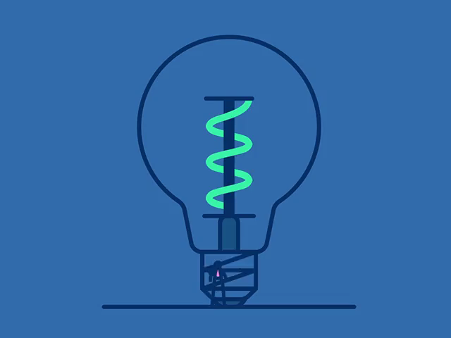
Gravitational potential energy is measured in joules (J), just like kinetic energy.
The mass of the object must be in kilograms (kg) and its height above the ground must be in meters (m).

Slide 9
This is the formula for gravitational potential energy:
GPE=m g h
The "g" stands for acceleration due to gravity. On Earth, this is always 9.8 ms⁻².
This means that gravitational potential energy is equal to the mass of an object multiplied by acceleration due to gravity multiplied by its height above the ground.

Slide 10

Lets practice using this formula.
A skydiver has a mass of 60 kg and they are 3000 m above the ground when they start their jump.
What is their gravitational potential energy?
GPE | =mgh
 | =60×9.8×3000
 | =?

Slide 11
Here is the rest of the equation:
GPE | =mgh
 | =60×9.8×3000
 | =1,764,000 J
This means that the skydiver has a gravitational potential energy of 1,764,000 J or 1,764 kJ.

